Slide 1
American Petroleum Institute
Suzanne Lemieux
07 22 2020

Slide 2
Our Role in Response
Understanding the needs and challenges our members are facing as a result of:
Operating conditions
Federal actions
State & local actions
Communicating with members, other trades, and the federal response community to provide timely, accurate and relevant information
Educating federal and state partners about the complexity of our industry, the unique needs of our members, and the importance of sustaining the energy supply chain in a crisis

Slide 3
How We’ve Prepared
API & members regularly participate in exercises to test the system
Lessons learned are incorporated after every event
Relationships are established and roles are identified in steady state
Resources are identified during planning and adapted during response and recovery

Slide 4
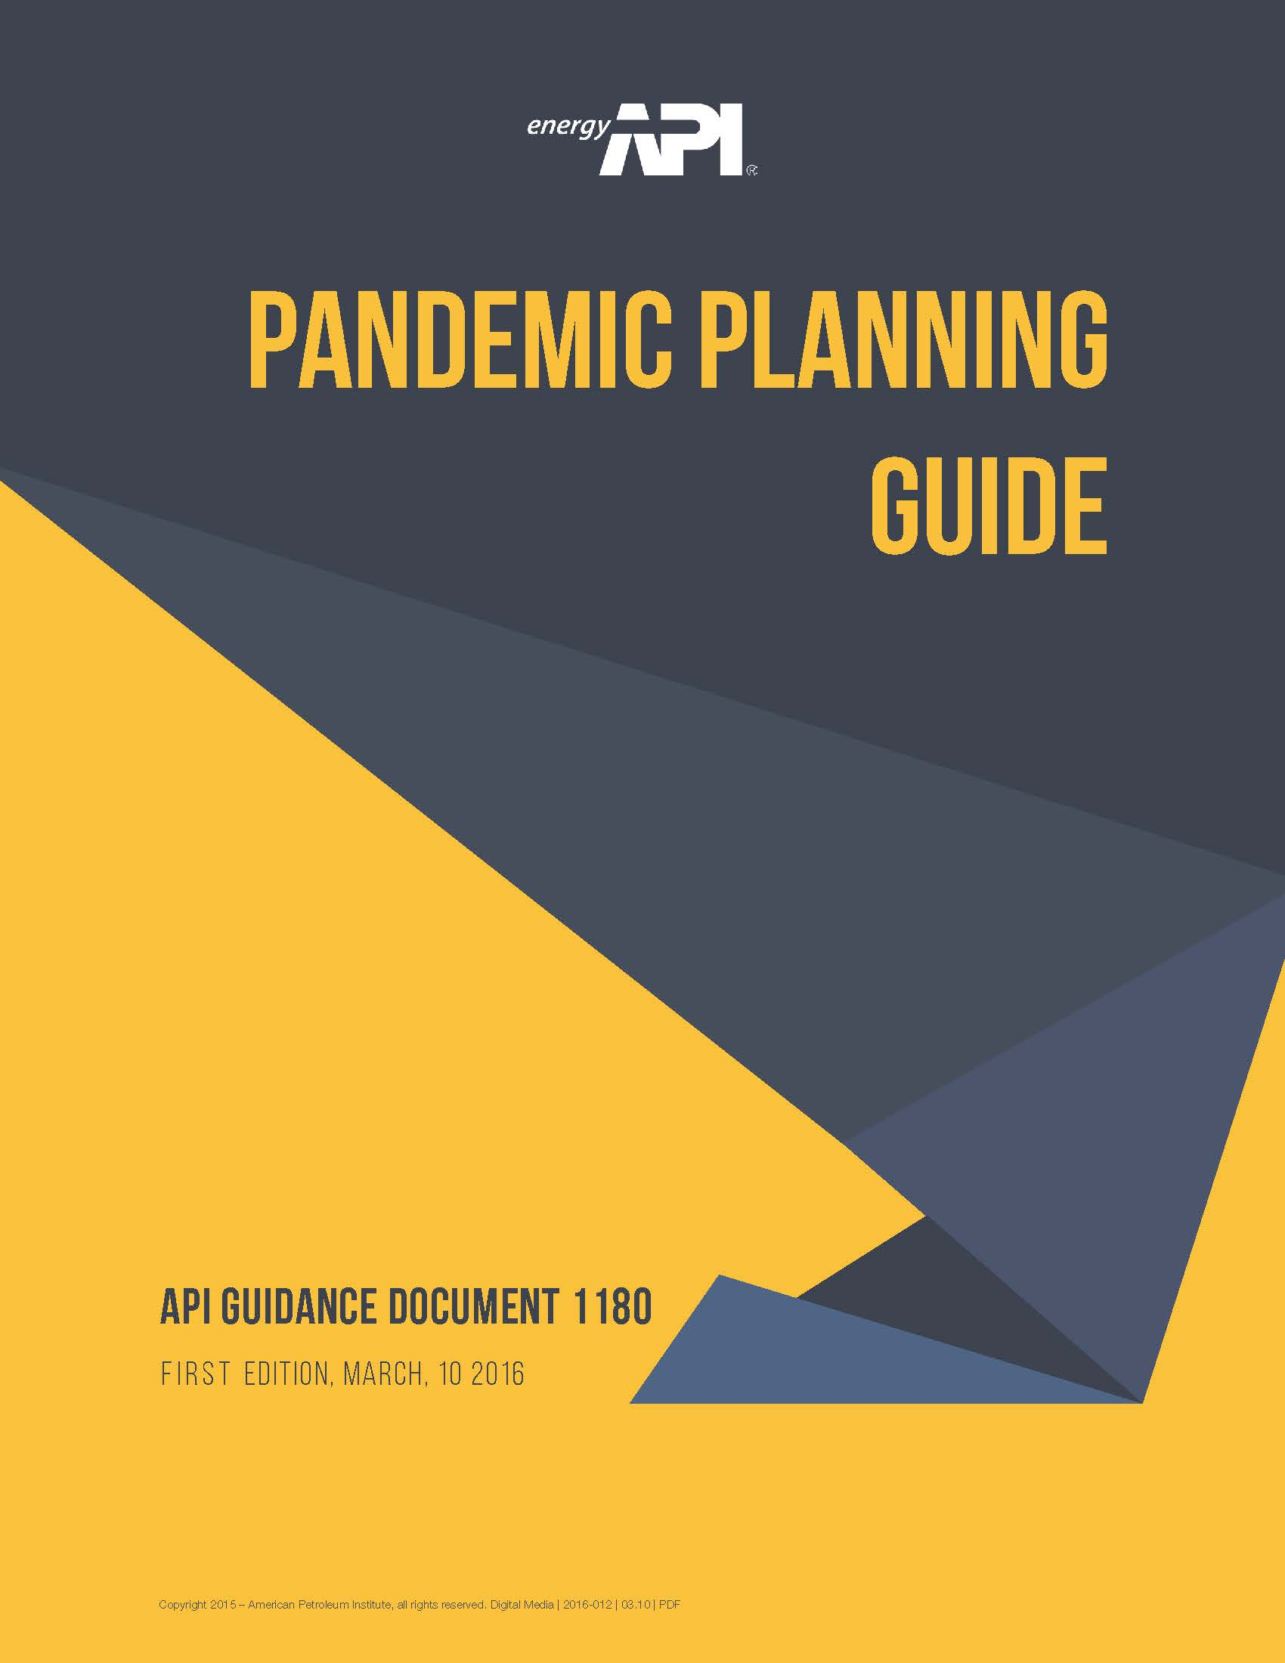
How We’ve Helped Members Plan for COVID-19
The API Pandemic Planning Guide was developed during the Ebola outbreak in west Africa in 2016
Members have been able to use the guide to assess their own plans or develop new plans
The Guide reflects the industry’s commitment to the safety of personnel and operations around the world
The Guide incorporates lessons from Ebola, SARS, MERS, H1-N1, and other pandemics members have responded to around the world

Slide 5
How We’re Helping
Working with federal partners to ensure oil and natural gas industry workers are designated essential
Working with states, and our State Petroleum Councils, to ensure state guidance aligns with CISA’s
Representing the industry to limit the burden on members actively responding

Slide 6
Tracking Industry’s Response
Where does API fit into members’ operational response?
API historically has helped industry benchmark their activities – “How do I compare with what others are doing?”
Keeping in mind antitrust concerns, API has been facilitating this need through a blinded pulse survey that goes out to members weekly.
Pulse Survey questions change weekly to reflect the current-state of response.

Slide 7
How Industry is Responding
Initial Response – COVID-19 Pulse Survey:
Point when companies went to all non-essential personnel started working remotely
How members considered precautions for their essential workers
Gauging whether members were able to get necessary PPE
Gauging whether members were able to ensure the movement of their essential personnel after stay-at-home orders were enacted
Continued Response – COVID-19 Pulse Survey Evolution:
How members are handling working remotely
How members are planning for return to work
Ensuring members are not having difficulties that API can help alleviate with federal partners
Ensuring members are looking ahead

Slide 8
Where We are Today
68% of respondents DO NOT have nonessential staff working in office locations at this time (two weeks ago this statistic was flipped – 65% of respondents had returned some nonessential staff to office/premises).
56% respondents indicated they have reverted back to earlier phases of reopening, delayed reopening further or returned staff to fully remote-work.
Of those who have nonessential staff returned to office/premises, the average percentage decreased from 40-50% two weeks ago to approximately 30% today (ranging from 10%-85% for respondents).

Slide 9
Where We are Today
Most respondents have made changes to plans to account for resurgence in cases in certain locations.
Half or respondents indicated they will be transitioning to fully virtual training, exercises and/or drills, with the other half doing a blend of virtual and in-person (limiting in-person participation).
Almost all respondents indicated air travel required Vice President or higher approvals.
The most common concerns expressed relate to the increased community transmissions in certain locations and the health of the workforce, inconsistent guidance from federal, state and local officials, and the analysis of data to inform decision-making regarding return to office/premises.

Slide 10
Planning Forward
People have expectations about time. Leaders shape expectations into reasonable order. What can happen in the near, mid and long term?
Expectation clarity enhances patience.
We will continue to engage with members, allied trades and government to address industry needs over the coming weeks and months.

