Slide 1
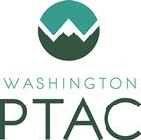
Veteran Business Certification Opportunities and Process
What you need to know to become certified
June 24, 2020
Notes:
Copyright © 2019 by The Contracting Education Academy at Georgia Tech. Permission is hereby granted to Procurement Technical Assistance Centers (PTACs), who are members in good standing of the Association of Procurement Technical Assistance Centers (APTAC), to use and modify this presentation in conjunction with the delivery of training and other services to clients. No other permission or use is granted.

Slide 2
About Us
Jeannet Santiago JSantiago@thurstonedc.com
Trena Payton tpayton@thurstonedc.com
Aleesha Roedel aroedel@greaterspokane.org
Washington PTAC’s mission is to increase the number of government contracts awarded to Washington firms so that those firms can grow.
Notes:
Describe your PTAC’s services, and invite attendees to become a client.
Always emphasize the importance of continuous learning!

Slide 3
Introductory Notes
This class covers the veteran-owned small business (VOSB) and service-disabled veteran-owned small business (SDVOSB) Verification to work with the VA (Veteran Affairs) and FAA (Federal Aviation Administration
State and local governments have small business programs/certifications, we won’t cover them here. Please contact your local PTAC Counselor for assistance. www.aptac-us.org
Notes:
Refer attendees to contact their local PTAC office for further assistance

Slide 4
VOSB/SDVOSB Certification Basics
There are two sets of rules governing VOSB/SDVOSB participation in federal contracts.
Under SBA rules, VOSB/SDVOSBs are allowed to “self-certify” their status to participate in all contracts except those administered by the VA.
To participate in VA contracts, VOSB/SDVOSBs first must go through a formal “verification” process, administered by the VA.
Notes:
Self-certify in sam.gov
To participate in VA contracts with the VA and FAA, they need their CVE

Slide 5
Before Pursuing VOSB/SDVOSB Certification, Questions to Consider…
Are you aware that the business type most favored by the federal government is small business?
Have you done any research to determine whether VOSB/SDVOSB certification could be beneficial?
Are you prepared, in terms of time and resources, to pursue the certification process?
Once granted a certification, are you prepared to implement a plan to “market” it?
Notes:
These questions are designed to encourage discussion with your audience. Make sure your audience is aware of the following:
All contracts valued at between $3,500 and $150,000 are automatically and exclusively set aside for small businesses. In addition, contracts above $150,000 generally are set aside if there are two or more small businesses that could compete for the work. Thus, qualifying – and self-certifying – as a small business may be the only certification needed.
Research into past federal contract awards to various categories of small businesses can provide insight into what’s likely to be future actions by the government in the future. Before pursuing the arduous task of certification, a business should figure out to what extent the certification will be helpful.
Certification applications are tedious, and often require a considerable amount of time and effort to prepare. A business also must be prepared to respond quickly to any follow-up inquiries by certifying agencies.
A record of successful past performance remains the key selling point in the government marketplace, but a certification could be the tipping point under the right circumstances. A business should have a plan for how it will effectively communicate its certification to federal contracting officials and seek the assistance of small business officials.

Slide 6
Why Are Small Business Programs Important?
The federal government has preferences and “set-asides” for all small businesses. A small business set-aside is based in part on the value and quantity of the goods or services the government wants to purchase.
Contract value | Small business set-aside requirement
$3,500 to $150,000 | Automatically and exclusively set aside for small businesses
$150,000 or more | Set aside if there are two or more small businesses that could do the work. ( 8(a), HUBZone, SDVO, and WOSB set-asides.)

Slide 7
What Businesses Qualify?
A for profit business
Business located in the U.S., and
Qualified as a small business under the criteria and size standards in 13 CFR Part 121 (which we’re going to talk about next).
Includes individuals, partnerships, corporations, joint ventures, associations, or cooperatives.

Slide 8
Size Standards
Size standards vary by industry, and are based on either the number of employees within the business or the company’s annual receipts.
Determine by primary NAICS code, or codes, that apply to a company’s operations.
Match up the codes with the SBA’s Small Business Size Standards. https://www.sba.gov/document/support--table-size-standards

Slide 9
Average “Receipts” or Revenue
The SBA uses the term Annual Receipts: This is the “total income” (or “gross income”) plus the “cost of goods sold.” These numbers can normally be found on a business’ IRS tax return forms.
Receipts are averaged over a business’ latest 3 to 5 complete fiscal years to determine the average annual receipts.
Notes:
If a business hasn’t been in business for 3 years or 5 years, multiply average weekly revenue by 52 to determine average annual receipts. When the business chooses 3 or 5, the business must stick to that (using 3 year receipts/5 year receipts).
§121.104 How does SBA calculate annual receipts?(c) Period of measurement. (1) Except for the Business Loan and Disaster Loan Programs, annual receipts of a concern that has been in business for 5 or more completed fiscal years means the total receipts of the concern over its most recently completed 5 fiscal years divided by 5. For certifications submitted on or before January 6, 2022, rather than using the definitions in this paragraph (c), a concern submitting a certification may elect to calculate annual receipts and the receipts of affiliates using either the total receipts of the concern or affiliate over its most recently completed 5 fiscal years divided by 5, or the total receipts of the concern or affiliate over its most recently completed 3 fiscal years divided by 3.
(2) Except for the Business Loan and Disaster Loan Programs, annual receipts of a concern which has been in business for less than 5 complete fiscal years means the total receipts for the period the concern has been in business divided by the number of weeks in business, multiplied by 52.

Slide 10
What Are NAICS Codes?
NAICS stands for North American Industrial Classification System.
It’s just the way the government classifies all businesses by different industry types.
Depending on what your business does, you may have one – or more than one – NAICS code.
Your business may be classified as small in one NAICS category, but you may not qualify as small in another.

Slide 11
Finding Your NAICS Codes
https://www.census.gov/eos/www/naics/
Notes:
Stress that it’s important for folks to spend some time to make sure they identify the correct NAICS code or codes that apply to their business!
If the presenter has an internet connection, he/she can click on the URL shown on this slide to go to the NAICS page and demonstrate how to search for codes by using multiple key words.

Slide 12
The VOSB/SDVOSB Program
Certification Steps
Notes:
Tell everyone you’re now going to talk about the specifics of obtaining HUBZone certification.

Slide 13
Pre-application Steps (1 of 2)
You must have a TIN/EIN.
You must obtain a DUNS number.
You must register in SAM – System for Award Management.
Be sure to complete your Dynamic Small Business Search (DSBS) profile at the end of SAM.
Make sure you know your NAICS before starting these steps!
Notes:
This slide is meant to remind everyone of what a PTAC normally advises in initial counseling sessions with new clients. Even if there are folks in attendance who have performed these basics, this slide will be a good reminder of how important these steps are.
Notes:
TIN and EIN are the same thing. The FAR says “Taxpayer Identification Number,” and the IRS calls it “Employer Identification Number.” Businesses can obtain an EIN on the IRS web site.
DUNS stands for “Data Universal Numbering System.” Obtaining a DUNS number is free. Businesses can obtain a DUNS number on the Dun & Bradstreet web site. Use of DUNS numbers are scheduled to be phased out by the federal government in December 2020. DUNS numbers will be replaced by a “unique entity identifier” called SAMMI which stands for SAM Managed Identifier.

Slide 14
Pre-application Steps (2 of 2)
Gathering, scanning, and storing electronic copies of all required documents depending on business type (A list of required documents is located at Required Documents for VIP Application) If a firm does not have a required document, a Detailed Letter of Explanation must be submitted explaining why the document is not included
Create a profile on the Vendor Information Profile (VIP)
Notes:
The last bullet states the point of this slide: There are lots of questions that can arise, and all of these references may need to be consulted to find the correct answers. We are going to cover only the basics in this class.
Individual questions like -- “What if I sell my company? How should I interpret ‘control’ in my company? What about owners’ stock options and their effect on whether or not I qualify as a small business? Can I have a silent partner?” -- are best answered on a one-on-one basis and not in a class setting.

Slide 15
Eligibility Standards
To qualify for the VOSB/SDVOSB program, a business must:
Meet the SBA’s small business size standards we’ve just discussed.
Be at least 51% owned and controlled by one or more veterans (for VOSB eligibility) or service-disabled veterans (for (SDVOSB eligibility).
Have one or more veterans (for VOSB eligibility) or service-disabled veterans (for SDVOSB eligibility) manage day-to-day operations and also make long-term decisions.
Eligible service-disabled veterans must have a service-connected disability.

Slide 16
Veteran - Definition
A Veteran is a person who served on active duty with the Army, Air Force, Navy, Marine Corps, or Coast Guard for any length of time and who was discharged or released under conditions other than dishonorable.
Reservists or members of the National Guard called to federal active duty or disabled from a disease or injury incurred or aggravated in the line of duty or while in training status also qualify as Veterans.

Slide 17
Service-Disabled Veteran - Definition
A Service-Disabled Veteran is a veteran who possesses either a disability rating letter issued by VA establishing a service-connected rating between 0 and 100 percent, or a disability determination from the Department of Defense.
If the Service-Disabled Veteran has a permanent and severe disability, the spouse or permanent caregiver can operate and control the management and daily business operations.

Slide 18
VA Verification
If you wish to be considered for set-aside and sole source contracts administered by the U.S. Department of Veterans Affairs, your business must be verified by the VA’s Center for Verification and Evaluation (CVE).
CVE may conduct an on-site examination at one or all of your offices or work sites. CVE may review any information related to your eligibility including, but not limited to, documentation related to the legal structure, ownership, and control. This includes your organizing documents, financial documents, and publicly available information as well as any other pertinent information.
Notes:
Tell your audience that the VA does not use the term certification. Instead, they use “verification.”

Slide 19
Ownership Standard
At least 51 percent of the business must be directly and unconditionally owned by one or more Veteran(s) or Service-disabled Veteran(s).
One or more service-disabled veterans must be entitled to receive at least 51 percent of the annual distribution of profits paid to the owners of a corporation, partnership, or limited liability company concern.
Notes:
13 CFR § 125.12(g)(1) provides that "[o]ne or more service-disabled veterans must be entitled to receive [a]t least 51 percent of the annual distribution of profits paid to the owners of a corporation, partnership, or limited liability company concern."
Previously, if a Veteran owner resided in any of the community property states or territories and was married, the Veteran was presumed to only own an undivided half (i.e., 50 percent of the community property). This is no longer the case for verification purposes. Thus, in states with community property laws, ownership is now determined without regard to community property. The Veteran need not submit evidence that the property is legally treated as separate property.

Slide 20
Control Standard
The Veteran owner(s) must have full control over the day-to-day management, decision-making, and strategic policy of the business; possess the managerial experience of the extent and complexity needed to manage the business; be the highest-compensated employee (unless the Veteran can explain how taking lower compensation benefits the business); devote full-time to the business; hold the highest officer position in the business; and have the ability to exercise independent business judgment.
Notes:
Devote Full Time to Business - This is current as of Jan 2020 - Preparing for Verification briefing. The theory behind this is that if the veteran cannot dedicate time to work for the company during normal business hours due to another part-time, full-time, (job or school) that the veteran cannot have "control" of the day-to-day and long term decision making of the business. Also attached is a brief for normal business hours.

Slide 21
Starting Point: SAM
SAM registration is a prerequisite to every certification.
Registrant indicates whether it is a corporation, partnership, LLC, sole proprietorship; a for-profit or nonprofit organization; and whether it is a VOSB, a SDVOSB, a WOSB, an EDWOSB, or a minority-owned business.
Remember, you must indicate that your firm is “for-profit” if it is to qualify as a small business.
Notes:
Another tip for your clients: Registrants should not opt-out of public display of their record because it makes them not visible to those who use SAM to search for small businesses.

Slide 22
Get familiar with the VA Site
https://www.va.gov/osdbu/verification/index.asp
Navigation video: https://www.youtube.com/watch?v=rMOMfQMPDxs&feature=youtu.be

Slide 23
Verify your Veteran Status
How does CVE use BIRLS? CVE uses BIRLS as well as the DD Form 214 to cross-reference information provided on the VA Form 0877.
https://www.va.gov/osdbu/docs/FactsheetBIRLS.pdf

Slide 24
Basic Documentation Required
Articles of Incorporation/Organization.
Corporate by-laws or operating agreements.
Shareholder agreements.
Voting records and voting agreements.
Trust agreements.
Franchise agreements, if applicable.
Organizational, annual, and board/member meeting records.
Stock ledgers and certificates.
State-issued Certificates of Good Standing.
Contract, lease and loan agreements.
Payroll records.
Bank account signature cards.
Financial statements.
Federal personal and business tax returns for up to 3 years.
Any applicable Licenses.

Slide 25
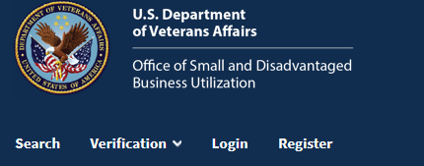
Begin Verification Application
To begin the verification application, go to www.vip.vetbiz.va.gov and hit the “Register” button at the top of the page.

Slide 26
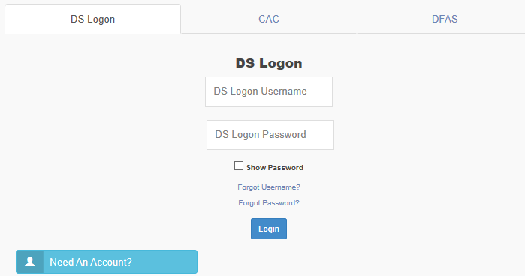
Obtaining a DS Logon – 1 of 2
To begin the process of obtaining a DS Logon, go to: myaccess.dmdc.osd.mil
Select the “DS Logon” tab as shown to the right and then click on “Need an Account?”

Slide 27
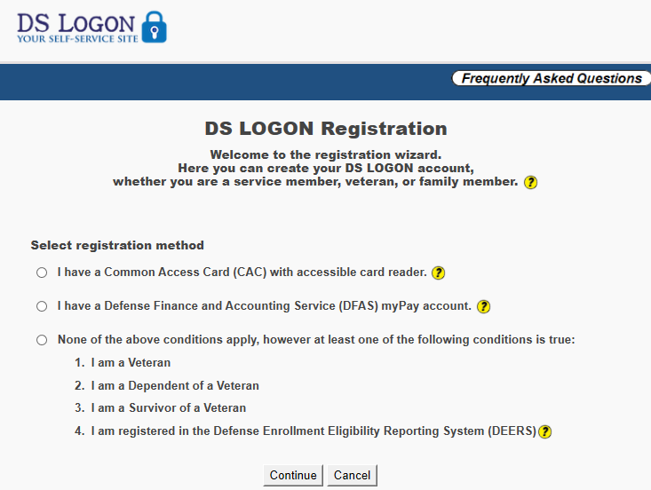
Obtaining a DS Logon – 2 of 2
You’ll next check the box marked at right.
From there, you will proceed through a series of several screens to establish identity and provide additional information.
✔
Notes:
If the veteran already has a DS Logon, then he or she can use their existing User Name and Password at the same site – myaccess.dmdc.osd.mil – to gain access
DFAS MyPay or eBenefits Usernames and Passwords are usually identical.

Slide 28
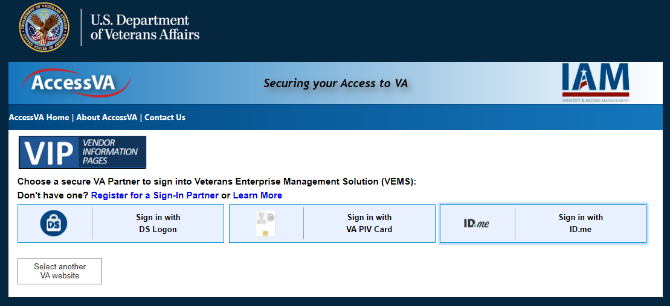
ID.me Accounts – 1 of 2
Non-veterans and others can obtain logon credentials by registering for an ID.me account.
To create an ID.me account, go to: access.va.gov/accessva/?cspSelectFor=vems and click on the button marked “Sign in with ID.me” button.

Slide 29
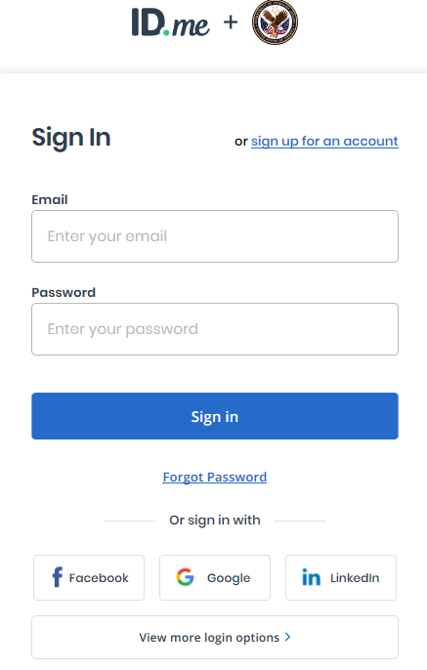
ID.me Accounts – 2 of 3
Then click on an “Accept” button to acknowledge terms of service and you will be presented with this screen where an ID.me account can be established.
Click on the link marked “sign up for an account” which will initiate a series of steps to establish an account.

Slide 30
Verification Process
Notes:
Intake
Intake Analyst:
Administers welcome phone call to applicant
Answers Veteran’s pre-application questions
Assists Veteran with gathering the required documents and submitting a complete application
Validates Veteran or Service-disabled Veteran status
Assessment
Case Analyst:
Performs a thorough review of all required documents to verify Veteran ownership and control eligibility
Provides the Veteran an opportunity to address any potential eligibility issue
Submits a recommendation for approval or denial to the Federal Review team
Federal Review
Federal Reviewer:
Conducts a quality check of the Case Analyst’s assessment to ensure accuracy of application
Prepares the draft determination letter
Submits a final recommendation for approval or denial to the CVE Director
Decision
CVE Director:
Makes the final decision to approve or deny application
Issues signed and dated verification determination letter via email to the applicant

Slide 31
Eligibility terms & reverification
The Verification of a business in VIP system will be valid for three years and will expire 36 months after last approval date.
The company will be able to apply for Re-verification within 120 days before the expiration date.
The company will get Re-verification notice and subsequent reminder notices by email.

Slide 32
Questions?
Jeannet Santiago JSantiago@thurstonedc.com
Trena Payton tpayton@thurstonedc.com
Aleesha Roedel aroedel@greaterspokane.org
www.washingtonptac.org

